Slide 1
Data Structure & Algorithms
Lecture 8
Recursion

Slide 2
Introduction
In C++, any function can call another function.
A function can even call itself.
When a function call itself, it is making a recursive call.
Recursive Call
  A function call in which the function being called is the same as the one making the call.
Recursion is a powerful technique that can be used in the place of iteration(looping).
Recursion
  Recursion is a programming technique in which procedures and functions call themselves.

Slide 3
Recursive Algorithm
Definition
  An algorithm that calls itself
Approach
  Solve small problem directly
  Simplify large problem into 1 or more smaller subproblem(s) & solve recursively
  Calculate solution from solution(s) for subproblem

Slide 4
Recursive Definition
A definition in which something is defined in terms of smaller versions of itself.
To do recursion we should know the followings
  Base Case:
    The case for which the solution can be stated non-recursively
    The case for which the answer is explicitly known.
  General Case:
    The case for which the solution is expressed in smaller version of itself. Also known as recursive case.

Slide 5

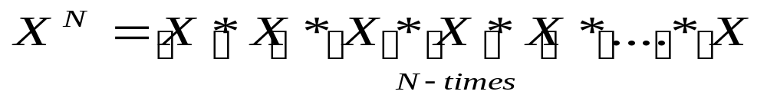
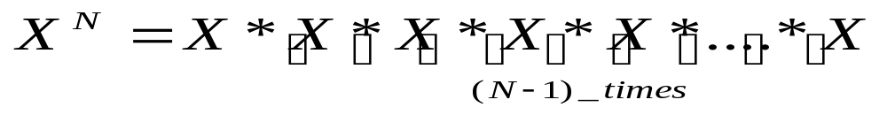
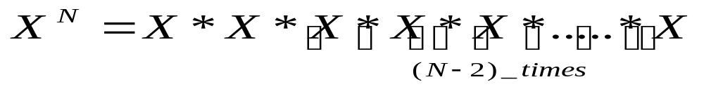

Example 1
We can write a function called power that calculates the result of raising an integer to a positive power. If X is an integer and N is a positive integer, the formula for is
We can also write this formula as
Also as
In fact we can write this formula as

Slide 6





Example 1(Recursive Power Function)
Now lets suppose that X=3 and N=4
Now we can simplify the above equation as
So the base case in this equation is
int Power ( int x , int n )
{
if ( n == 1 )
return x; //Base case
else
return x * Power (x, n-1);
// recursive call
}

Slide 7
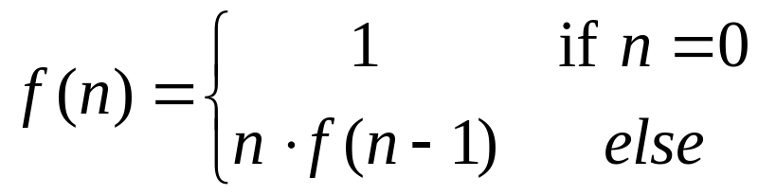
Example 2 (Recursive Factorial Function)
Factorial Function:
Given a +ive integer n, n factorial is defined as the product of all integers between 1 and n, including n.
So we can write factorial function mathematically as

Slide 8
Example 2 (Recursive Factorial Function)
Factorial definition
  n! = n × n-1 × n-2 × n-3 × … × 3 × 2 × 1
  0! = 1
To calculate factorial of n
  Base case
    If n = 0, return 1
  Recursive step
    Calculate the factorial of n-1
    Return n × (the factorial of n-1)

Slide 9
Example 2 (Recursive Factorial Function)
int factorial(n)
{
if(n == 0) //Base Case
return 1;
else
return n * factorial(n-1); //Recursion
}

Slide 10
Evaluation of Factorial Example
  To evaluate Factorial(3)
  evaluate 3 * Factorial(2)
  To evaluate Factorial(2)
  evaluate 2 * Factorial(1)
  To evaluate Factorial(1)
  evaluate 1 * Factorial(0)
  Factorial(0) is 1
  Return 1
  Evaluate 1 * 1
  Return 1
  Evaluate 2 * 1
  Return 2
  Evaluate 3 * 2
  Return 6

Slide 11
Recursive Programming
main
factorial(3)
return 6
factorial(3)
3 * factorial(2)
return 2
factorial(2)
2*factorial(1)
return 1
factorial(1)
1*factorial(0)
return 1
factorial(0)

Slide 12
Rules For Recursive Function
In recursion, it is essential for a function to call itself, otherwise recursion will not take place.
Only user define function can be involved in recursion.
To stop the recursive function it is necessary to base the recursion on test condition and proper terminating statement such as exit() or return must be written using if() statement.
When a recursive function is executed, the recursive calls are not implemented instantly. All the recursive calls are pushed onto the stack until the terminating condition is not detected, the recursive calls stored in the stack are popped and executed.
During recursion, at each recursive call new memory is allocated to all the local variables of the recursive functions with the same name.

Slide 13
The Runtime Stack during Recursion
To understand how recursion works at run time, we need to understand what happens when a function is called.
Whenever a function is called, a block of memory is allocated to it in a run-time structure called the stack.
This block of memory will contain
  the function’s local variables,
  local copies of the function’s call-by-value parameters,
  pointers to its call-by-reference parameters, and
  a return address, in other words where in the program the function was called from. When the function finishes, the program will continue to execute from that point.

Slide 14
Exercise
The problem of computing the sum of all the numbers between 1 and any positive integer N can be recursively defined as:
N
N-1
N-2
= N +
= N + (N-1) +
i = 1
i = 1
i = 1
= etc.

Slide 15
Exercise
int sum(int n)
{
if(n==1)
return n;
else
return n + sum(n-1);
}

Slide 16
Recursion in ADT
You can also use recursion in the data structures such as Stacks, queues, linked list, trees etc.
Task
  Write a recursive function Search. Which will search the given number in the linked list.
  Steps involved in searching
    Base case
      If list is empty or search reached end of the list, return false
      If number is found in the list, return true
    Recursive step
      Perform recursion for the next node in the list until you find the required element.

Slide 17
Exercise
Write a recursive function to display the data member of Linked list OR Queues.
Write a recursive function to display the data members of linked List in reverse order.

Slide 18
Tail Recursion
A recursive function is called tail recursive if only one recursive call appears in the function and that recursive call is the last statement in the function body.
This approach provides decreased stack implementation time and gives faster execution.
  node* find_value(node *temp, int value)
  {
  if (temp == NULL)
  return NULL;
  if (temp->data == value)
  return temp;
  return find_value(temp->next, value);
  }

Slide 19
Indirect Recursion
A function is indirectly recursive if it contains a call to another function which ultimately calls originally calling function.
The following pair of functions is indirectly recursive. Since they call each other, they are also known as mutually recursive functions.
      int foo(int x)
      { if (x <= 0) return x;
      return bar(x);
      }
      int bar(int y)
      { return foo(y - 1);
      }

